Slide 1
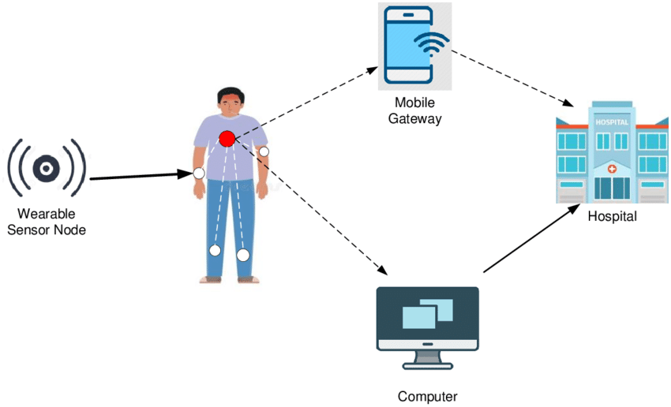
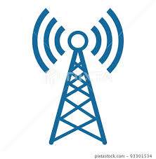

NARROW BAND ANTENNA FOR WIRELESS BODY AREA NETWORKS (WBANs)
TEAM COMPOSITION
SUJEETH T 927622BEC217
VARUN NATRAJ V 927622BEC244
YOGESH V 927622BEC251
VIGNESH S 927622BEC309
GUIDED BY Dr. K. KARTHIKEYAN
ASSOCIATIVE PROF/ECE

Slide 2
INTRODUCTION
Antennas are essential in Wireless Body Area Networks (WBANs) to enable wireless communication between wearable devices and Implantable system.
They facilitate the transmission of data collected by sensors on the wearable devices to smartphones allowing for real-time monitoring, and interaction in various applications such as healthcare, sports, and wellness.
Antennas in WBANs ensure reliable and efficient communication while maintaining low power consumption and on the whole of various good factors.

Slide 3

PROBLEM STATEMENT
The PS includes factors such as limited space for the antenna placement,
tissue absorption effects, signal attenuation, interference from the
surrounding objects, and need for low power consumption.
The goal is to design antennas that are compact, efficient and capable of
Reliable communication in diverse wearable scenarios, while also
considering factors like biocompatibility and ease of integration into wearable devices.

Slide 4

OBJECTIVE
Wireless connectivity: RF enables wireless communication between health and monitoring devices.
Data Transmission: Approximate frequency of 4.5GHz – 4.75 GHz, which enables high – speed data transmission, facilitating real-time streaming of vital medical data.
Penetration and Range: This frequency balances penetration into body tissue and range, ensuring reliable communication within the body.
Interference Mitigation: The obtained range is less prone to interference, ensuring uninterrupted data transmission in healthcare environments.

Slide 5
EXSISTING SYSTEM
Zigbee: Offering low-power, low-data rate communication over longer distances than Bluetooth, Zigbee is suitable for transmitting sensor data in WBANs for applications like remote patient monitoring.
Medical Implant Communication Service (MICS): MICS is specifically designed for medical implants and enables reliable communication between implanted devices and external controllers or monitors.

Slide 6

PROPOSED SYSTEM
We are proposing an Novel antenna design which will be specifically operating in the range of 4.749 GHz and used for Wireless Body Area networks (WBANs).
These antennas could be integrated into wearable devices or implanted devices to monitor vital signals (cardiac rhythm), track patient movements, or facilitate communication between medical devices and external system.
The devices such as ECG monitors, blood glucose meters, and pulse oximeters which will be very helpful for the intensive care patients.

Slide 7

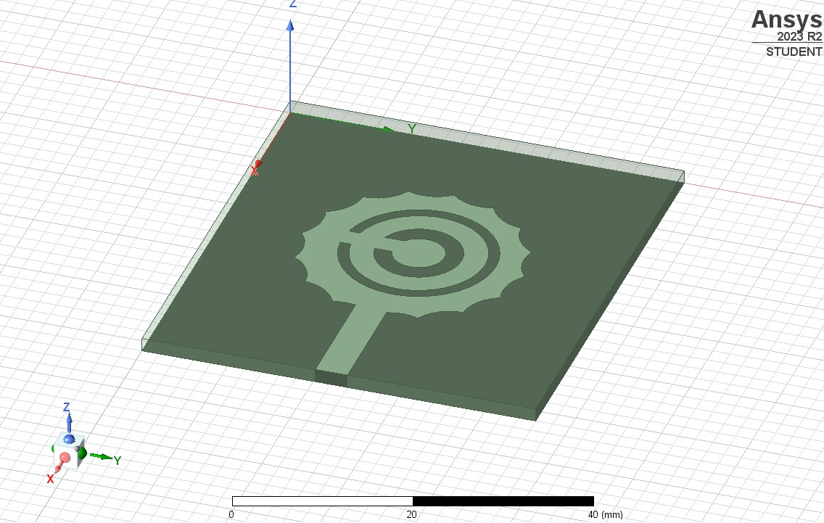
Novel Antenna Design

Slide 8
Design parameters
The proposed design with a polygonal of 16 edges
Bandwidth Expansion: Increasing edges and circular slots into the antenna , the operating bandwidth can be expanded, it cover a wider range of frequencies and maintain a efficient performance.
Size and Weight Reduction: Design of SRR circular slots contribute to size reduction and weight savings, making a compact antenna and portable without sacrificing performance.
Enhanced Gain: The addition of circular slots can increase the antenna's gain, improving its ability to transmit and receive signals over longer distances or in challenging environments.
Improved Frequency Selectivity: Circular slots introduce additional resonant frequencies, enhancing the antenna's ability to selectively operate on multiple frequencies simultaneously or with increased sensitivity.

Slide 9
ANTENNA DESCRIPTION
The proposed design is consist 16 edge polygonal.
INFO | MEASUREMENTS
SUBSTRATE:WIDTH,LENGTH,HEIGHT | 46mm,52mm,1.6mm
ANTENNA TYPE | MICROSTRIP PATCH ANTENNA
POLYGONAL : Sides , Radius | 16,13mm
CIRCLES(No:16) | Radius: 7mm
Split Ring Resonator (circles) | Width:R1=1.2,R2=3
FEED (WIDTH),(LENGTH) | 4mm,14mm
PORT(Lumped port):Width , Length | 3.7 ,1.6

Slide 10
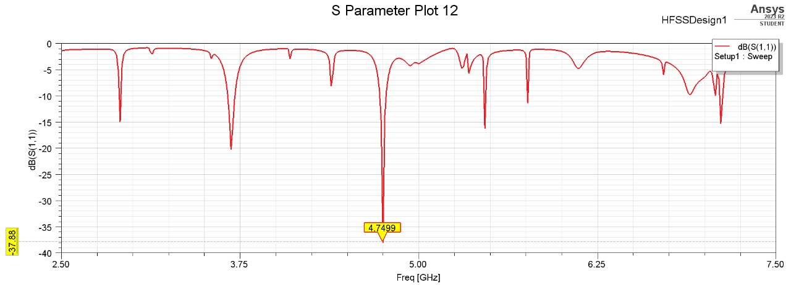
FREQUENCY VS GAIN PLOT

Slide 11
RESULT ANALYSIS
The proposed antenna design will be an output of 4.749 Ghz and a overall gain of -37.88 db.
Here we are getting an Narrow band with the gain is more than -20 db which will be have more transmission efficiency.
So the proposed antenna design is very much helpful in the field of wireless communication in (WBANs).

Slide 12
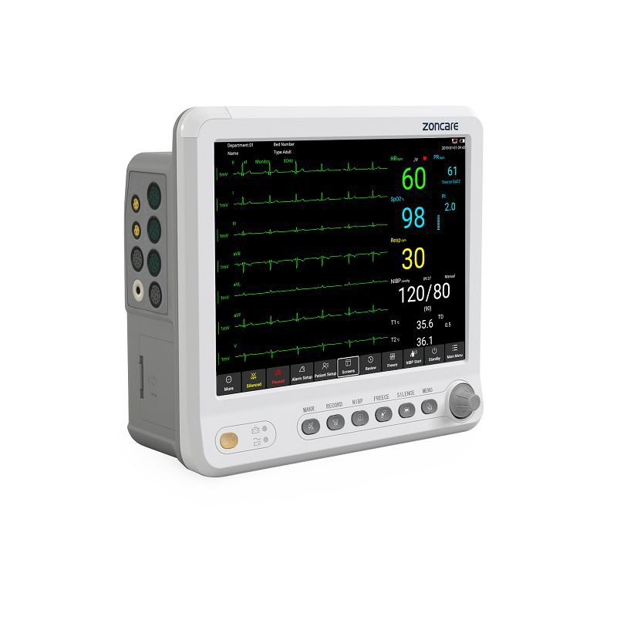
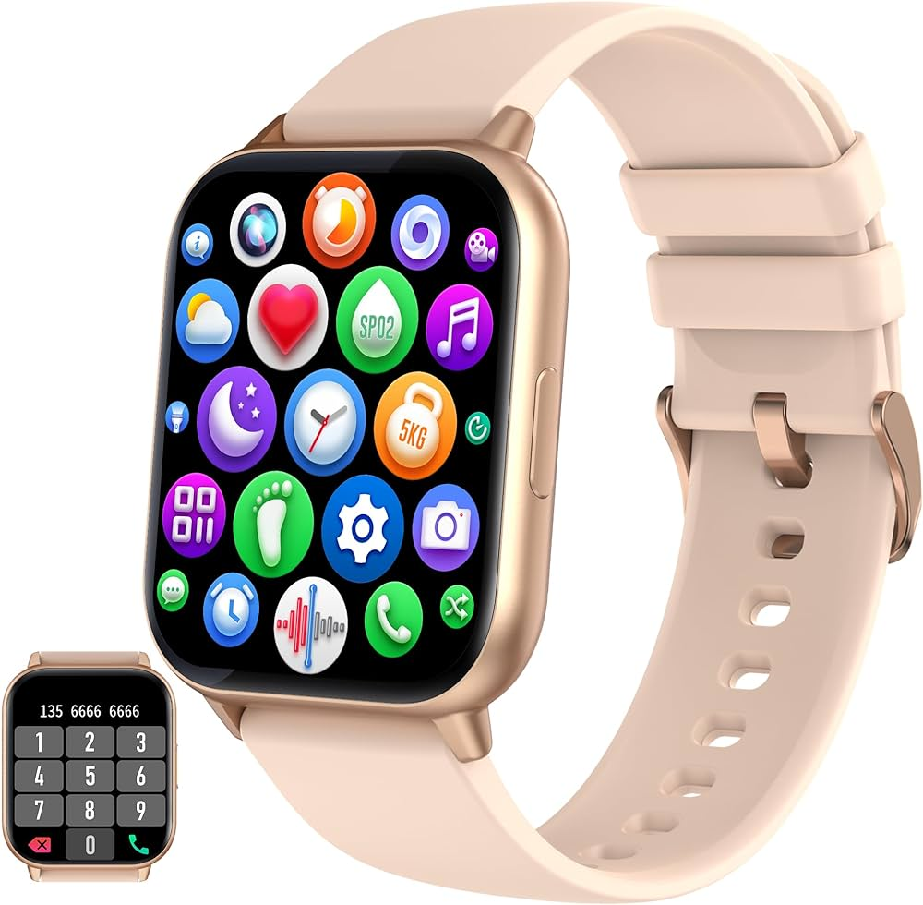
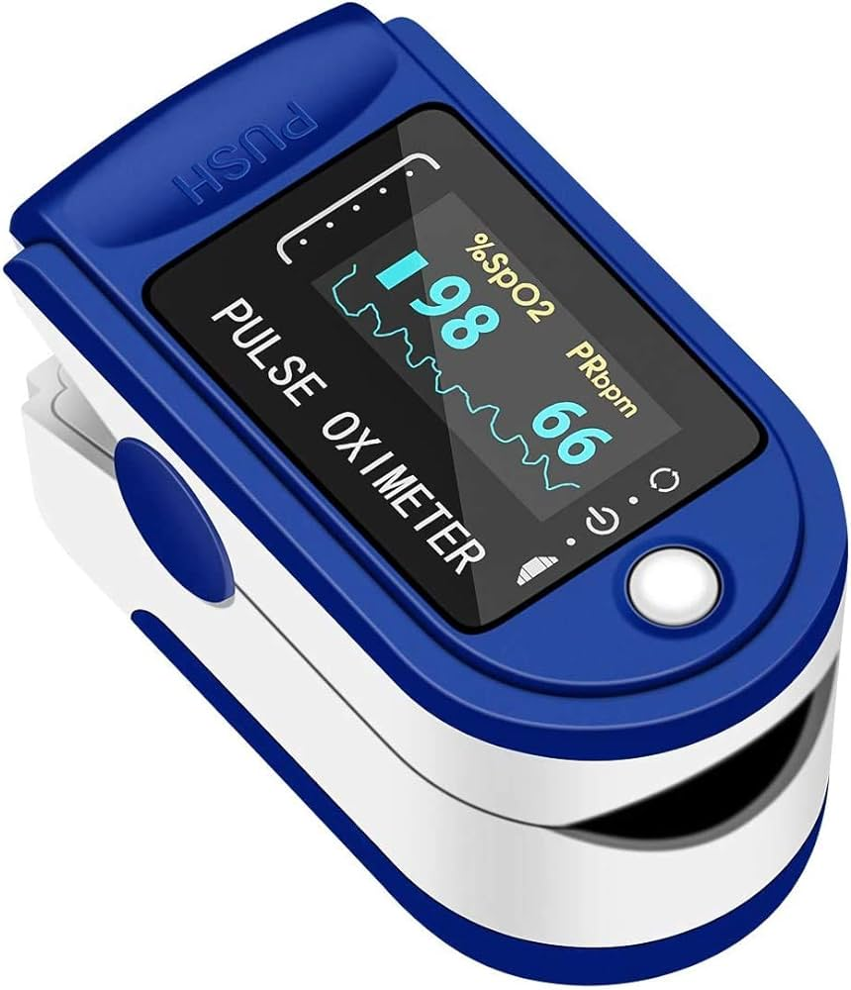
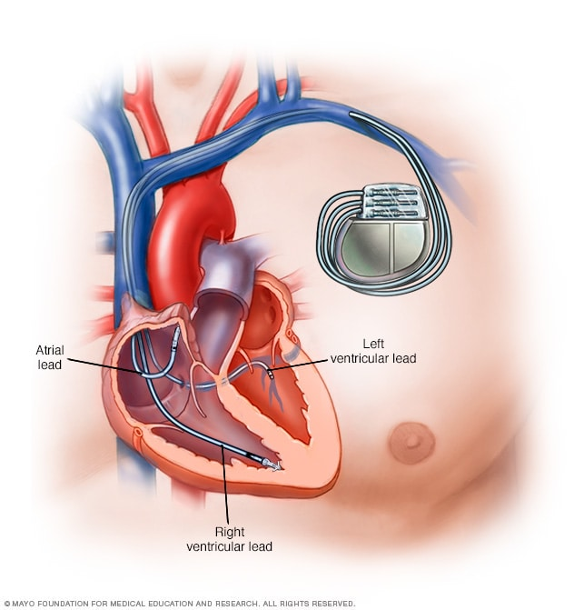
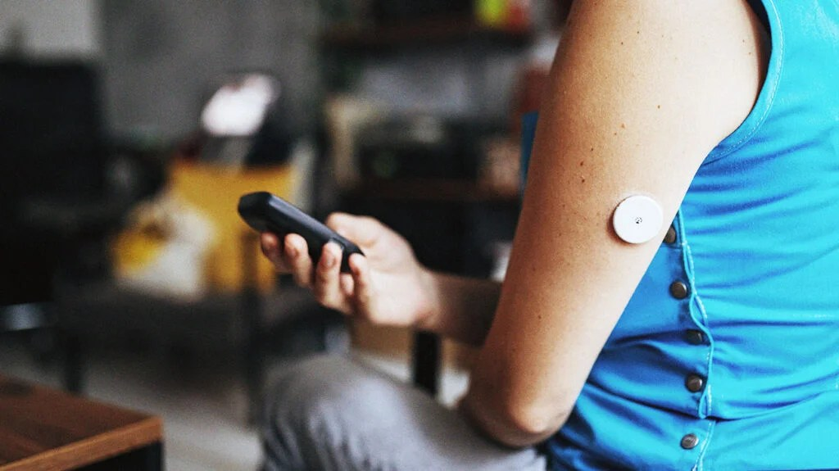
APPLICATIONS

Slide 13
B
L
O
C
K
D
I
A
G
R
A
M
PROPOSED ANTENNA
PRECISE TRANSMISSION OF E.M. WAVES AT 4.789 GHz
MEASURE OF THE HUMAN VITALS BY EXSISTING DEVICES
TRANSMISSION OF VITALS VIA OUR ANTENNA
REAL TIME DATA TRANSMISSION
OUTPUT ON A CONNECTED DEVICES
EXAMPLE : HEART RHYTHM MONTORING,
IMPLANTABLE GLUCOSE MONITOR,
PACEMAKERS

Slide 14
PROS OF PROPOSED ANTENNA WHEN COMPATED TO EXSISTING SYSTEMS
Improved Signal Penetration: The 4.7 GHz frequency band exhibits good penetration through the human body, allowing signals to propagate through tissues with minimal attenuation. This enables more reliable communication between wearable devices placed on different parts of the body.
Spectral Efficiency: Narrowband communication allows for efficient use of the available frequency spectrum, enabling more devices to operate simultaneously without causing significant interference.

Slide 15
PLAN OF WORK COMPLETION
We had simulated this, proposed antenna design which yields good results of -37.88 db.
We are further planed to increased the efficiency of narrow band by increasing its results.

Slide 16
CONCLUSION
In conclusion, the utilization of RF technology, particularly at the
frequency of 4.5 GHz, in healthcare applications such as Wireless
Body Area Networks (WBANs) for continuous patient monitoring.
This underscores its significance in advancing healthcare technology and improving patient outcomes.

Slide 17
REFERENCES
1. "Wireless Body Area Networks: Technology, Implementation, and Applications" Author: Mehmet R. Yuce.
2. "RF and Microwave Wireless. Systems" Author: Kai Chang.
3.https://www.researchgate.net/publication/353480566_DEVELOPMENT_OF_WEARABLE_PATCH_ANTENNAS_USING_RUBBER_SUBSTRATE_FOR_WBAN_APPLICATIONS.
4. ResearchGatehttps://www.researchgate.net › 353...development of wearable patch antennas using various substrate .

